Slide 1


Clinical Data Interchange Standards Consortium
(CDISC) 101: Mapping SDTM and ADaM Variables
Lesson 3b: Processing AE, SUPPAE and ADAE adverse datasets
Sunil Gupta, Gupta Programming
SASSavvy.com
Notes:
Copyright (C) 2013, Sunil Gupta
CDISC 101: Mapping Variables
SASSavvy.com

Slide 2
Collection of AE Tables based on factors (10 core tables, up to 30 tables)
Safety Population | By System Organ Class and Preferred Term | By System Organ Class, Preferred Term and Severity*
No subset | 1 | 2
Drug Related** | 3 | 4
Severity or Serious** | 5 | 6
Drug Related and Serious** | 7 | 8
Additional AE Tables
Overall AE Summary | 9
Most Frequent AEs (>= 10%)*** | 10
Additional By Variable | 11 - 20
Additional Subset Population* | 21 - 30
* Select the Highest Severity Level (Severe, Moderate and Mild)
** Subset condition
*** >= 10% of the total column

Slide 3
Collection of AE Tables based on factors (Two Part PROC SORT)
Level | Table Type | BY Variables
1 | SUBJECT Counts | SUBJECT
2 | SUBJECT and SOC Counts | SUBJECT, SOC
3 | SUBJECT, SOC and PT Counts | SUBJECT, SOC, AEDECOD
Part 1: PROC SORT using DESCENDING to get highest severity level (severe, moderate or mild)
proc sort data=ae out=ae_sev;
by subject soc aedecod descending aesev;
run;
Part 2: PROC SORT with NODUPKEY option to get only one record per subject, soc and aedecod
proc sort data=ae_sev nodupkey;
by subject soc aedecod;
run;

Slide 4
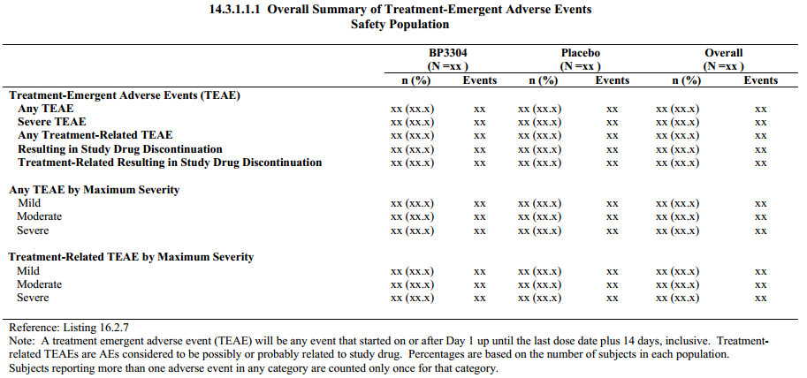
Example of AE Table from ADAE
N = # of pts with AE
(%) = # of pts with AE/total # of pts
Events = # of events with AE

